Slide 1
Data Analytics: Module-1
Dr. Ramen Pal Associate Professor Department of CSE (AI & ML), UEMK
Contact: ramen.pal@uem.edu.in WhatsApp: 7501038078

Slide 2
Course Details
Subject Name: Professional Elective - III : Data Analytics
Credit: 3
Subject Code: PECCSE602A
Lecture Hours: 36

Slide 3
Course Outcome
On completion of the course students will be able to:
CO-1: Discuss with illustration the techniques and methods related to the area of data collection, pre-processing, and exploratory data analytics.
CO-2: Discuss important terms and techniques on statistics to enable student to understand the background of different tools or methods used in data analytics.
CO-3: Use at beginning level of proficiency on the tools of machine learning to ask questions of and explore patterns in data.
CO-4: Demonstrate intermediate proficiency in the visualization of data to communicate information and patterns that exist in the data.

Slide 4
Syllabus: Module-1 (Introduction to Data Analytics)
Data science workflow, Automated methods for data collection, Data and Visualization Models, Data wrangling and cleaning, Exploratory data analysis, Dimensionality Reduction. Building and evaluation of models for: Association Analysis, Recommendation Systems, Time-series data, Text Analysis, Data Mining.

Slide 5
Introduction to data
We often use the term data to refer to computer information
This information is either transmitted or stored
Data comes in numerous forms
Any kind of information may it be in numbers or text, or pictures is termed as Data

Slide 6
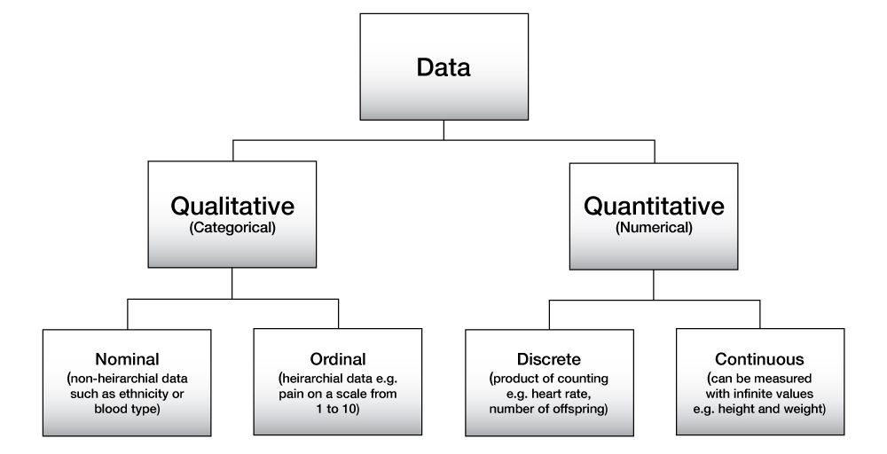
Types of data
*Grouping method is used to examine nominal data. It usually represented using pie charts

Slide 7
Discrete vs Continuous data
Discrete
Can be expressed as a specific value.
For example, “Number of months in a year“, “Number of members in a family” etc.
Continuous
Can be any value in an interval
For example, “The amount of oxygen in the atmosphere”, “Age of members in a family”

Slide 8
Dataset: Types of data
Data comes in different types. Some of the common types of data include:
Text
Image
Video
Numbers
Spreadsheets
Sound

Slide 9
Real world applications of data
Predicting interests of the audience on different online video streaming platforms
Getting insights from customer reviews in online stores, food delivery apps etc.
Effective targeting of the advertisements

Slide 10
Data Visualization
Data visualization is the representation of data or information in a graph, chart, or other visual formats
The goal of data visualization is to communicate information clearly and efficiently to users.
Provides a way to see and understand trends, outliers, and patterns in data.

Slide 11
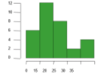
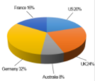

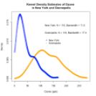
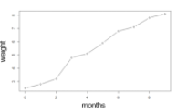
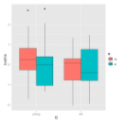
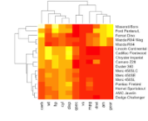
Data Visualization: Charts
Bar chart
Pie Chart
Histogram
Kernel density plot
Line chart
Box plot
Heat map
Fig: Different types of charts

Slide 12
What Is Data Science?
Extracting meaningful insights from data is known as data science.
Data when investigated and carefully analyzed, provides insights which enriches our daily lives

Slide 13
What Is Data Science?
Data science is the domain of study that deals with vast volumes of data using modern tools and techniques to find unseen patterns, derive meaningful information, and make business decisions.
Data science uses complex machine learning algorithms to build predictive models.
The data used for analysis can come from many different sources and presented in various formats.

Slide 14
The Data Science Lifecycle
Data science’s lifecycle consists of five distinct stages, each with its own tasks:
Capture: Data Acquisition, Data Entry, Signal Reception, Data Extraction. This stage involves gathering raw structured and unstructured data.
Maintain: Data Warehousing, Data Cleaning, Data Staging, Data Processing, Data Architecture. This stage covers taking the raw data and putting it in a form that can be used.
Process: Data Mining, Clustering/Classification, Data Modeling, Data Summarization. Data scientists take the prepared data and examine its patterns, ranges, and biases to determine how useful it will be in predictive analysis.
Analyze: Exploratory/Confirmatory, Predictive Analysis, Regression, Text Mining, Qualitative Analysis. Here is the real meat of the lifecycle. This stage involves performing the various analyses on the data.
Communicate: Data Reporting, Data Visualization, Business Intelligence, Decision Making. In this final step, analysts prepare the analyses in easily readable forms such as charts, graphs, and reports.

Slide 15
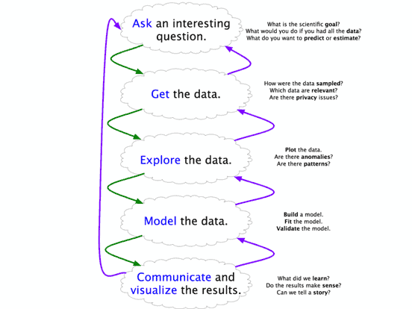
Data Science Workflow

Slide 16
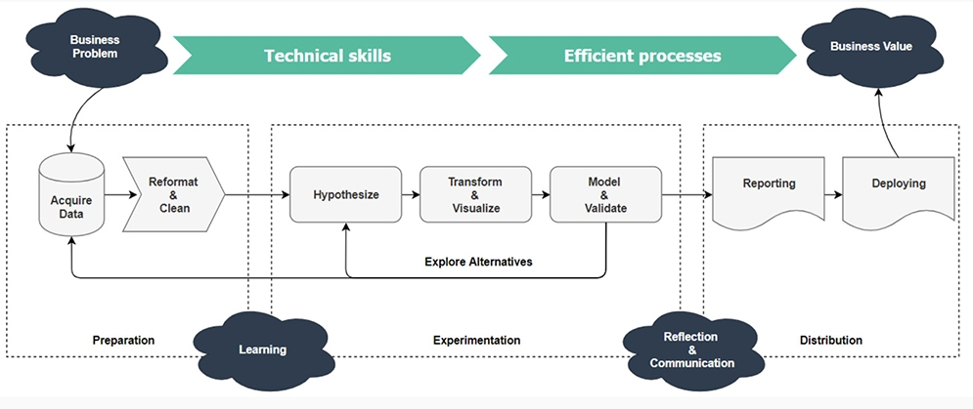
Data Science Workflow

Slide 17
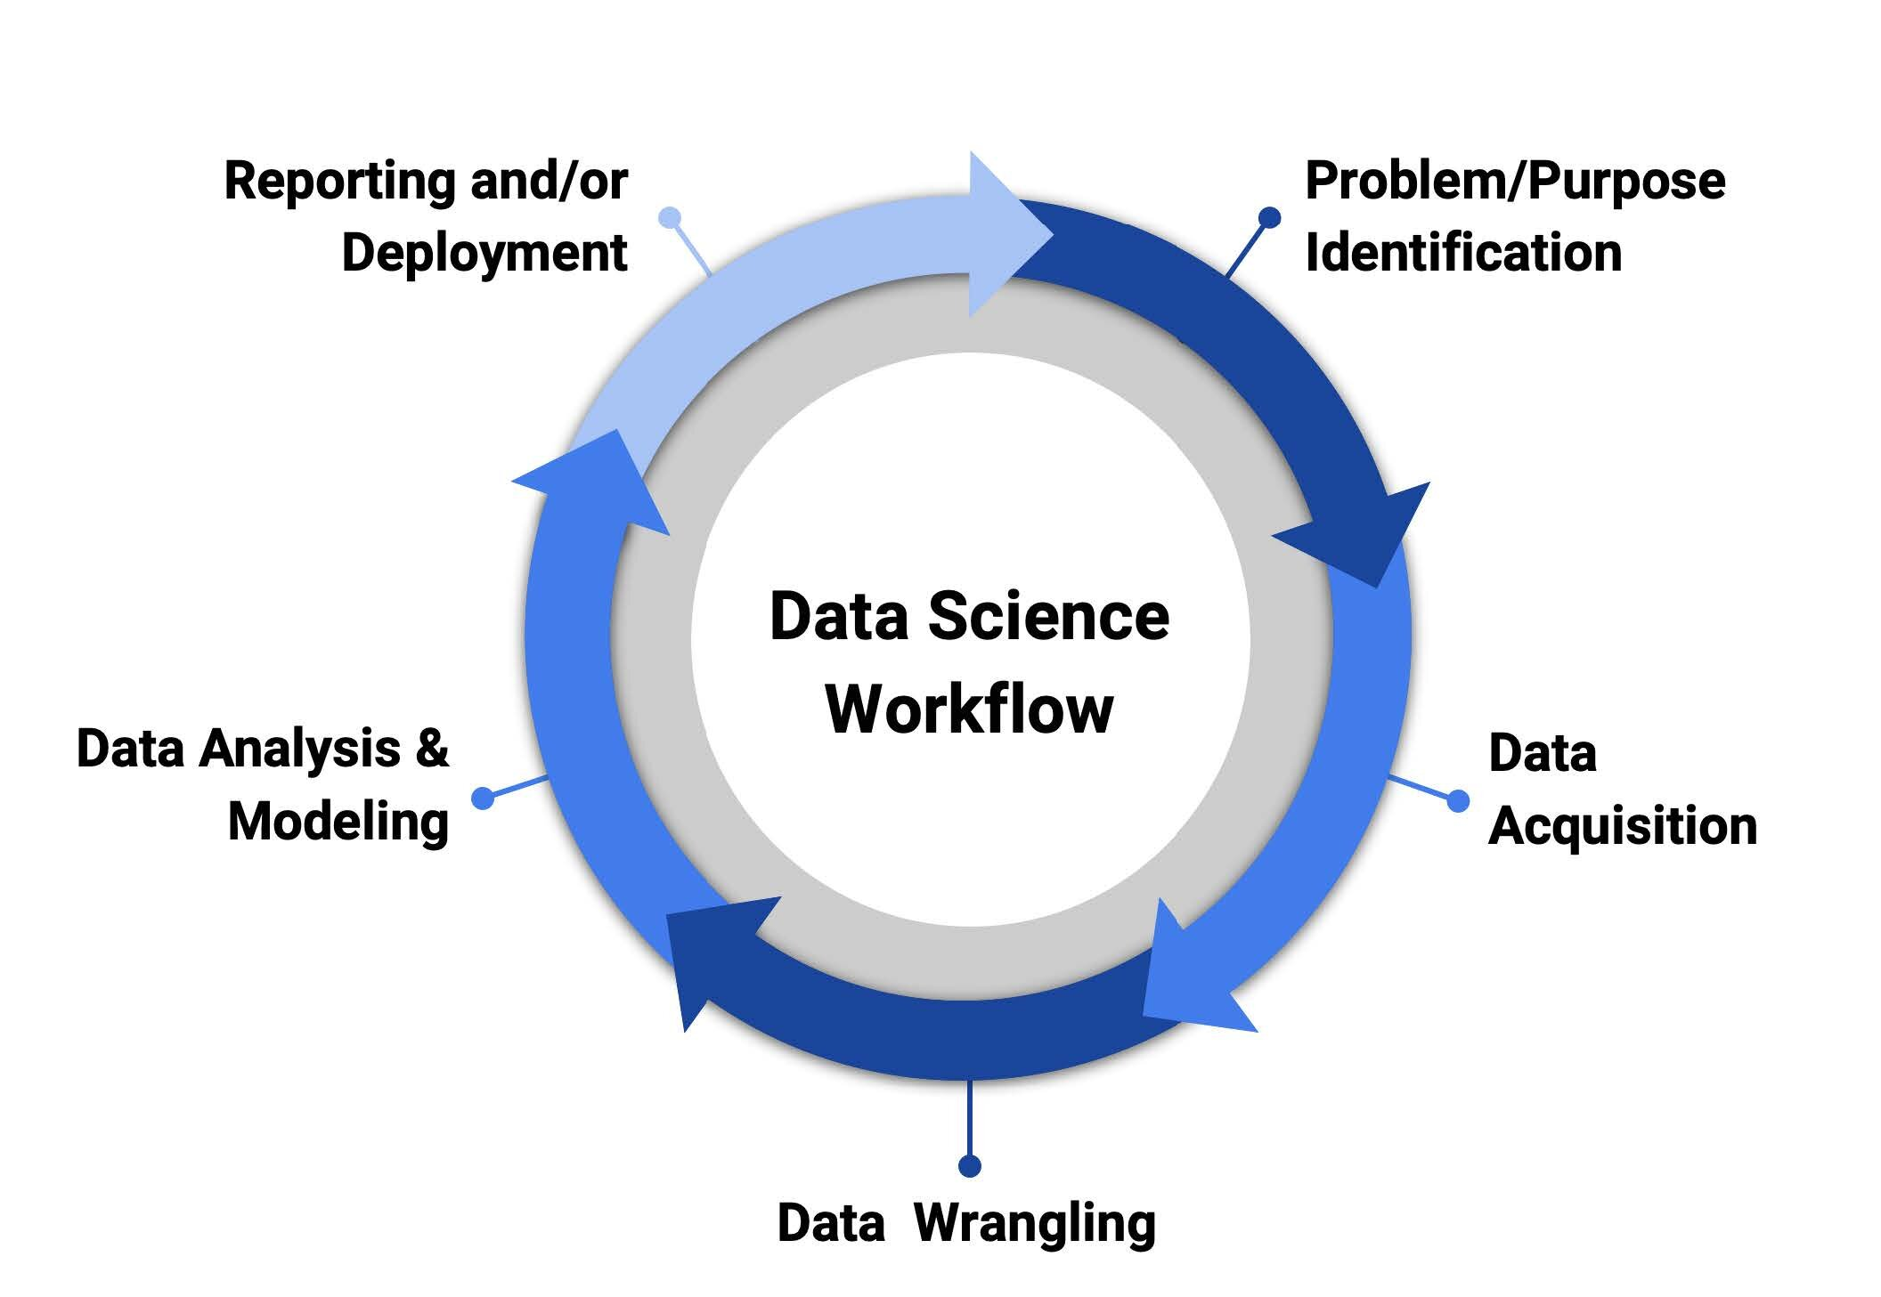
Data Science Workflow

Slide 18
Data Wrangling
Data wrangling ensures data is reliable and complete, before professionals analyze it and use it to create insights. Thanks to this process, those insights are based on accurate, high-quality data.
Anaconda's “The State of Data Science 2022” report revealed that data scientists spend about 37.75% of their time data wrangling, a percentage that’s a sharp reduction from past surveys, which placed the estimate at closer to 80%.
If you’re considering a career in data, at some point, you’ll likely have to deal with data wrangling in some capacity.

Slide 19
Data Wrangling
Data wrangling also goes by a few other names, including data cleaning, scrubbing, and remediation.
It's an umbrella term that describes several processes designed to transform raw data from messy, complex data sets into more easily used formats.
When you engage in data wrangling, you find and transform data so you can use it to answer a question or produce valuable insight needed to make decisions.
Professionals conduct data wrangling in one of two ways: manually or automated.
Data scientists and other team members usually head up the data wrangling process in businesses with a data team.
In smaller organizations, it may fall to non-data professionals to clean data before use.

Slide 20
Data Wrangling: Why it matters?
Imagine building the Taj Mahal on a shoddy foundation or if the builder who constructed your home slapped it together without paying meticulous detail to the quality of the foundation and the building supplies. Data wrangling works similarly as a solid foundation for research and analytics.
Once the process is complete, you'll get results much faster with less chance of errors or missed opportunities. You make raw data usable when you use data-wrangling tools and follow the steps. Other benefits include:
Data wrangling enables you to gather data from multiple sources into a central spot.
Cleaning and converting data into a standard format enables you to perform cross-data set analytics.
Data wrangling prepares data by removing flawed and missing elements, readying it for data mining, and empowering businesses to make concrete, data-driven decisions.

Slide 21
Data Wrangling: Steps
Harvard Business School Online identifies six common processes used to inform your approach to data wrangling:
Data Discovery
Data Structuring
Data Cleaning
Data Enriching
Data Validating, and
Data Publishing
If you work with data, you’ll likely also work with several tools to help you easily navigate the data-wrangling process.
Some popular tools include Tabula, DataWrangler, Pandas, and Python.
Each project might require you to take a slightly different approach and may present unique challenges throughout the process.

Slide 22
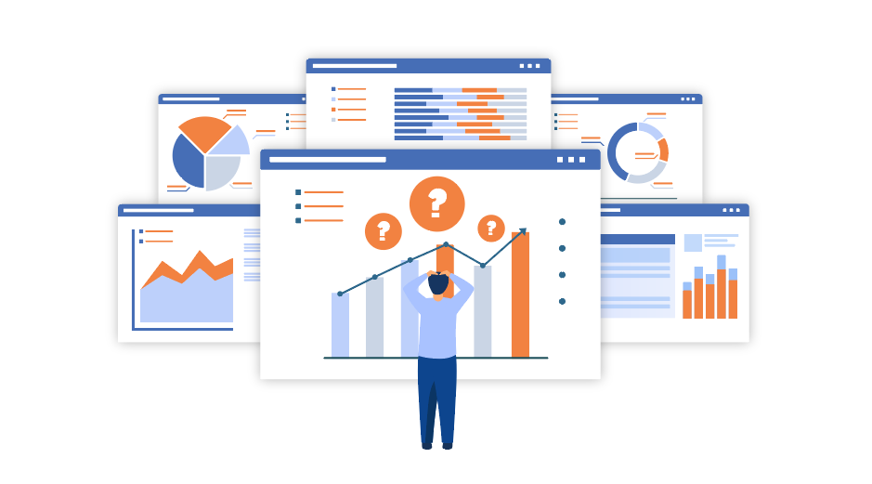
Data Discovery
The first step helps you make sense of the data you're working with. You'll also need to keep the primary goal of the data analysis during this step. For example, if your organization wants to gain customer behavior insight, you might sort customer data according to location, promotional codes, and purchases.

Slide 23

Data Structuring
Once you've finished the first step, you might find raw data that could be more organized, complete, or misformatted for your purposes. That's where data structuring comes into play. This is the process in which you transform that raw data into a form appropriate for the analytical model you want to use to interpret the data.

Slide 24

Data cleaning
During the data cleaning step, you remove data errors that might distort or damage the value of your analysis. This includes tasks like standardizing inputs, deleting empty cells, removing outliers, and deleting blank rows. Ultimately, the goal is to ensure the data is as error-free as possible.

Slide 25
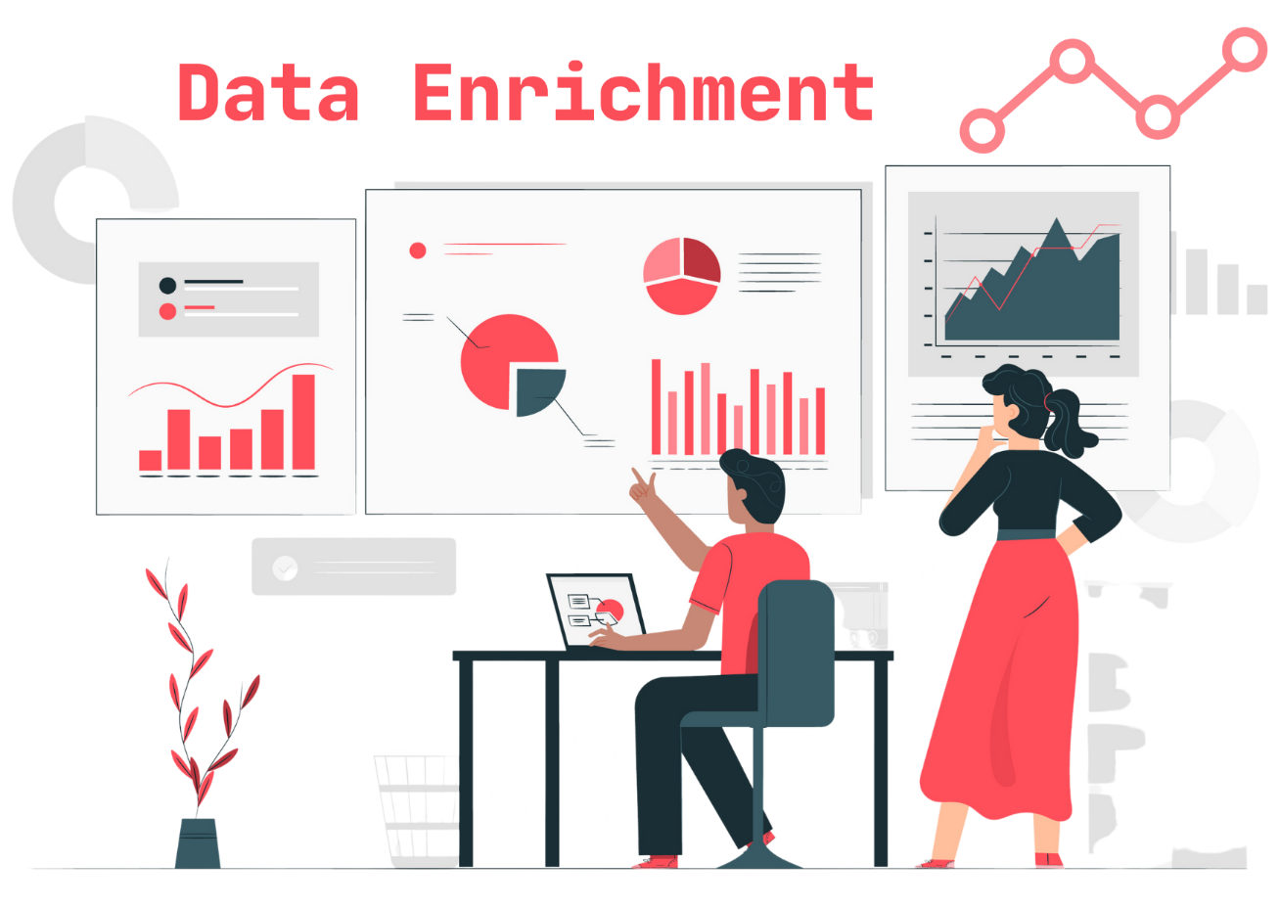
Enriching data
Once you've transformed your data into a more usable state, you must determine if you have all the data you need for the project. If you don't, you can enrich it by adding values from other data sets. And if you do so, you might have to repeat steps one through three for that new data.

Slide 26

Data Validation
When you work on data validation, you verify that your data is consistent and of sufficient quality. During this step, you might find some issues you need to address or that the data is ready to be analyzed. This step is typically completed using automated processes and requires some programming skills.

Slide 27
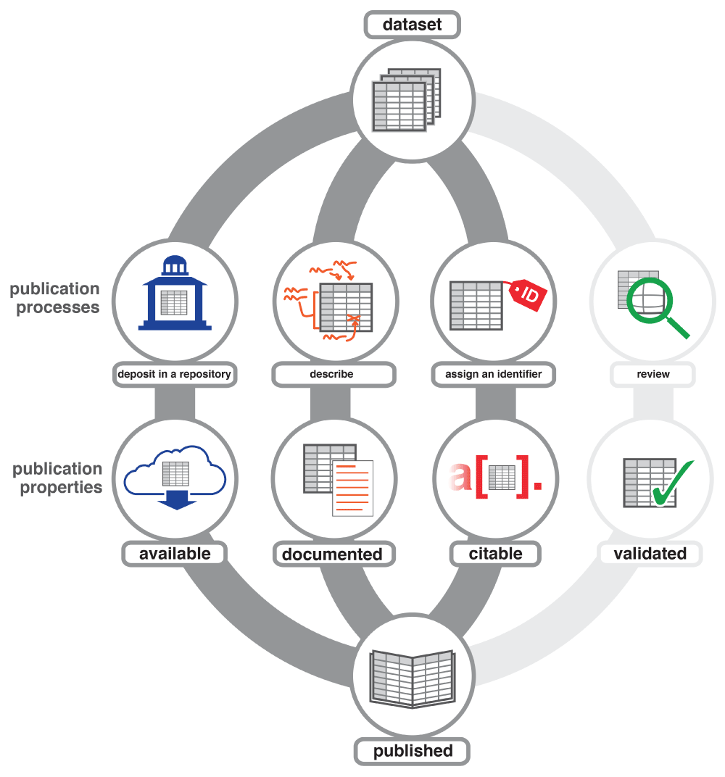
Data Publishing
After validating your data, you're ready to publish it. In this step, you'll put it into whatever format you prefer for sharing with other organization members for analysis purposes. Use written reports or digital files, depending on the nature of the data and the organization's overarching goals.

Slide 28
Motivation for a future Employee
The data-wrangling market itself is predicted to remain strong. According to Mordor Intelligence, the market could reach $2.28 billion USD by 2026, up from $1.31 billion USD in 2020.
Your job outlook will likely depend on the role you ultimately choose to pursue. The average annual salaries for several common roles include:
Data scientist: ₹8,98,897
Data warehouse developer: ₹4,68,690
Database administrator: ₹5,23,115

Slide 29
Prerequisites for Data Science
Machine Learning
Modeling
Statistics
Programming (i.e. python, R. Python etc.)
Databases

Slide 30
Who Oversees the Data Science Process?
Business Managers: The business managers are the people in charge of overseeing the data science training method. Their primary responsibility is to collaborate with the data science team to characterize the problem and establish an analytical method.
IT Managers: Data science teams are constantly monitored and resourced accordingly to ensure that they operate efficiently and safely. They may also be in charge of creating and maintaining IT environments for data science teams.
Data Science Managers: The data science managers make up the final section of the tea. They primarily trace and supervise the working procedures of all data science team members. They also manage and keep track of the day-to-day activities of the three data science teams. They are team builders who can blend project planning and monitoring with team growth.
Data scientists are among the most recent analytical data professionals who have the technical ability to handle complicated issues as well as the desire to investigate what questions need to be answered.

Slide 31
Who Oversees the Data Science Process?
Business Managers: The business managers are the people in charge of overseeing the data science training method. Their primary responsibility is to collaborate with the data science team to characterize the problem and establish an analytical method.
IT Managers: Data science teams are constantly monitored and resourced accordingly to ensure that they operate efficiently and safely. They may also be in charge of creating and maintaining IT environments for data science teams.
Data Science Managers: The data science managers make up the final section of the tea. They primarily trace and supervise the working procedures of all data science team members. They also manage and keep track of the day-to-day activities of the three data science teams. They are team builders who can blend project planning and monitoring with team growth.
Data scientists are among the most recent analytical data professionals who have the technical ability to handle complicated issues as well as the desire to investigate what questions need to be answered.

Slide 32
On a daily basis, a data scientist may do the following tasks:
Discover patterns and trends in datasets to get insights.
Create forecasting algorithms and data models.
Improve the quality of data or product offerings by utilising machine learning techniques.
Distribute suggestions to other teams and top management.
In data analysis, use data tools such as R, SAS, Python, or SQL.
Top the field of data science innovations.

Slide 33
What Does a Data Scientist Do?
A data scientist analyzes business data to extract meaningful insights. In other words, a data scientist solves business problems through a series of steps, including:
Before tackling the data collection and analysis, the data scientist determines the problem by asking the right questions and gaining understanding.
The data scientist then determines the correct set of variables and data sets.
The data scientist gathers structured and unstructured data from many disparate sources—enterprise data, public data, etc.
Once the data is collected, the data scientist processes the raw data and converts it into a format suitable for analysis. This involves cleaning and validating the data to guarantee uniformity, completeness, and accuracy.
After the data has been rendered into a usable form, it’s fed into the analytic system—ML algorithm or a statistical model. This is where the data scientists analyze and identify patterns and trends.
When the data has been completely rendered, the data scientist interprets the data to find opportunities and solutions.
The data scientists finish the task by preparing the results and insights to share with the appropriate stakeholders and communicating the results.

Slide 34
Use of Data Science
Data science may detect patterns in seemingly unstructured or unconnected data, allowing conclusions and predictions to be made.
Tech businesses that acquire user data can utilise strategies to transform that data into valuable or profitable information.
Data Science has also made inroads into the transportation industry, such as with driverless cars.
Data Science applications provide a better level of therapeutic customization through genetics and genomics research.

Slide 35
Where Do You Fit in Data Science?
Data science offers you the opportunity to focus on and specialize in one aspect of the field.
Data Scientist
Job role: Determine what the problem is, what questions need answers, and where to find the data. Also, they mine, clean, and present the relevant data.
Skills needed: Programming skills (SAS, R, Python), storytelling and data visualization, statistical and mathematical skills, knowledge of Hadoop, SQL, and Machine Learning.
Data Analyst
Job role: Analysts bridge the gap between the data scientists and the business analysts, organizing and analyzing data to answer the questions the organization poses. They take the technical analyses and turn them into qualitative action items.
Skills needed: Statistical and mathematical skills, programming skills (SAS, R, Python), plus experience in data wrangling and data visualization.

Slide 36
Where Do You Fit in Data Science?
3. Data Engineer
Job role: Data engineers focus on developing, deploying, managing, and optimizing the organization’s data infrastructure and data pipelines. Engineers support data scientists by helping to transfer and transform data for queries.
Skills needed: NoSQL databases (e.g., MongoDB, Cassandra DB), programming languages such as Java and Scala, and frameworks (Apache Hadoop).

Slide 37
Data Science Tools
Data Analysis: SAS, Jupyter, R Studio, MATLAB, Excel, RapidMiner
Data Warehousing: Informatica/ Talend, AWS Redshift
Data Visualization: Jupyter, Tableau, Cognos, RAW
Machine Learning: Spark MLib, Mahout, Azure ML studio

Slide 38
Applications of Data Science
Data science has found its applications in almost every industry.
Healthcare: Healthcare companies are using data science to build sophisticated medical instruments to detect and cure diseases.
Gaming: Video and computer games are now being created with the help of data science and that has taken the gaming experience to the next level.
Image Recognition: Identifying patterns in images and detecting objects in an image is one of the most popular data science applications.
Recommendation Systems: Netflix and Amazon give movie and product recommendations based on what you like to watch, purchase, or browse on their platforms.
Logistics: Data Science is used by logistics companies to optimize routes to ensure faster delivery of products and increase operational efficiency.

Slide 39
Applications of Data Science
Fraud Detection: Banking and financial institutions use data science and related algorithms to detect fraudulent transactions.
Internet Search: When we think of search, we immediately think of Google. Right?
Speech recognition: Speech recognition is dominated by data science techniques. We may see the excellent work of these algorithms in our daily lives. Have you ever needed the help of a virtual speech assistant like Google Assistant, Alexa, or Siri?
Targeted Advertising: If you thought Search was the most essential data science use, consider this: the whole digital marketing spectrum. From display banners on various websites to digital billboards at airports, data science algorithms are utilised to identify almost anything.
Airline Route Planning: As a result of data science, it is easier to predict flight delays for the airline industry, which is helping it grow.
Augmented Reality: Last but not least, the final data science applications appear to be the most fascinating in the future.

Slide 40
Example of Data Science
Here are some brief overviews of a couple of use cases, showing data science’s versatility.
Law Enforcement: In this scenario, data science is used to help police in Belgium to better understand where and when to deploy personnel to prevent crime.
Pandemic Fighting: The state of Rhode Island wanted to reopen schools, but was naturally cautious, considering the ongoing COVID-19 pandemic. The state used data science to expedite case investigations and contact tracing, enabling a small staff to handle an overwhelming number of concerned calls from citizens. This information helped the state set up a call center and coordinate preventative measures.
Driverless Vehicles: Lunewave, a sensor manufacturing company, was looking for a way to make sensor technology more cost-effective and accurate. They turned to data science and machine learning to train their sensors to be safer and more reliable, as well as using data to improve their 3D-printed sensor manufacturing process.
Entertainment: Data science enables streaming services to follow and evaluate what consumers view, which aids in the creation of new TV series and films.

Slide 41
Example of Data Science
Finance: Banks and credit card firms mine and analyze data in order to detect fraudulent activities, manage financial risks on loans and credit lines, and assess client portfolios in order to uncover upselling possibilities.
Manufacturing: Data science applications in manufacturing include supply chain management and distribution optimization, as well as predictive maintenance to anticipate probable equipment faults in facilities before they occur.
Healthcare: Machine learning models and other data science components are used by hospitals and other healthcare providers to automate X-ray analysis and assist doctors in diagnosing illnesses and planning treatments based on previous patient outcomes.
Retail: Retailers evaluate client behavior and purchasing trends in order to provide individualized product suggestions as well as targeted advertising, marketing, and promotions. Data science also assists them in managing product inventories and supply chains in order to keep items in stock.

Slide 42
Example of Data Science
Finance: Banks and credit card firms mine and analyze data in order to detect fraudulent activities, manage financial risks on loans and credit lines, and assess client portfolios in order to uncover upselling possibilities.
Manufacturing: Data science applications in manufacturing include supply chain management and distribution optimization, as well as predictive maintenance to anticipate probable equipment faults in facilities before they occur.
Healthcare: Machine learning models and other data science components are used by hospitals and other healthcare providers to automate X-ray analysis and assist doctors in diagnosing illnesses and planning treatments based on previous patient outcomes.
Retail: Retailers evaluate client behavior and purchasing trends in order to provide individualized product suggestions as well as targeted advertising, marketing, and promotions. Data science also assists them in managing product inventories and supply chains in order to keep items in stock.

